Slide 1

Big Mountain Resort
Revenue and Cost Modeling Data Analysis
Notes:
Executives - the decision makers

Slide 2
Problem identification
Big Mountain would like to increase the overall revenue for the resort but, it is not known how well Big Mountain is capitalizing on its facilities and which features command a higher price

Slide 3
Recommendation & Key findings
The Random Forest model was selected based on the fact it has a lower cross-validation mean absolute error by almost $1 and exhibits less variability.
The model was used to confirm that there is adequate data within the dataset.
The model identifies key features and their relative importance on ticket price.

Slide 4
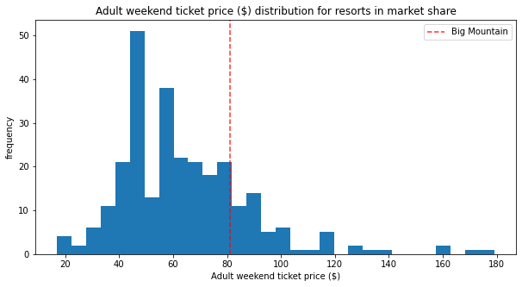
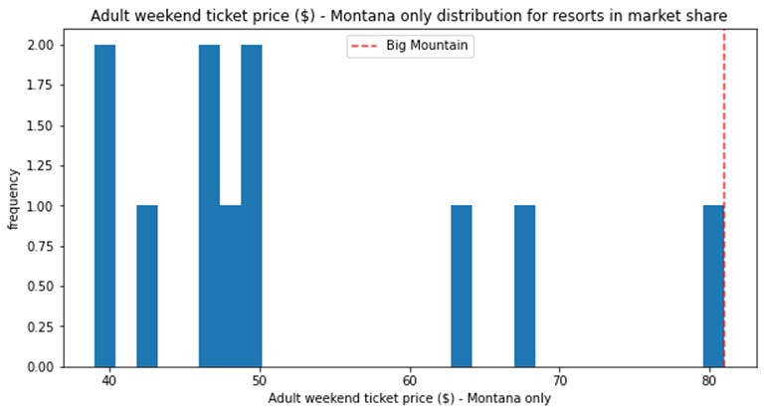
Modeling results and analysis
The Big Mountain Resort is already one of the highest priced resorts amongst all resorts
The Big Mountain resort is the highest priced resort in all of Montana

Slide 5
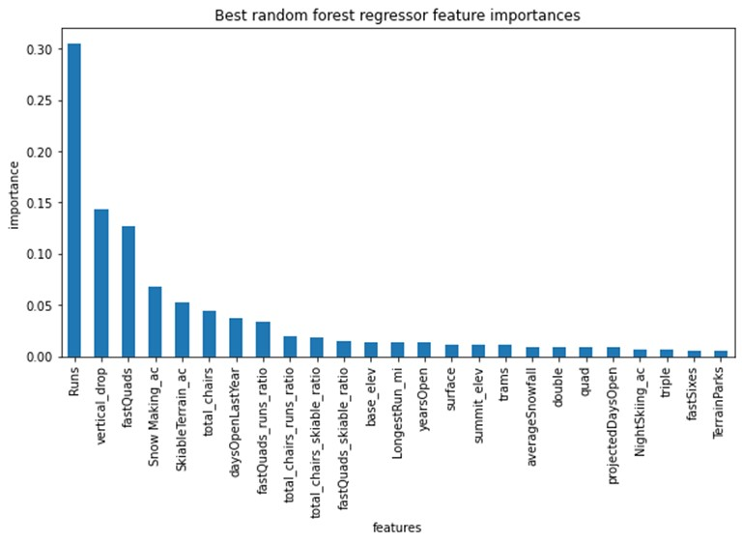
Modeling results and analysis
Many features have an impact on overall price
These features can be visualized in terms of relative importance
While this data gives information on which features drive higher revenue prices, this does not provide insight into the relative

Slide 6
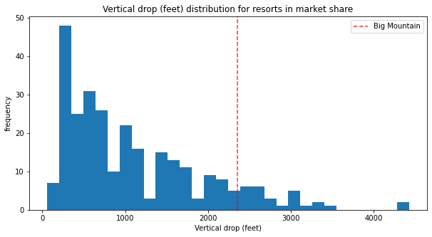
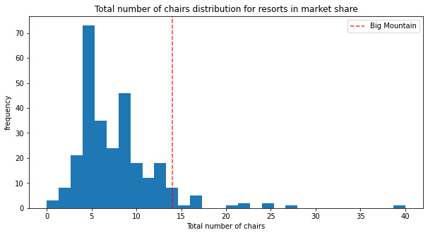
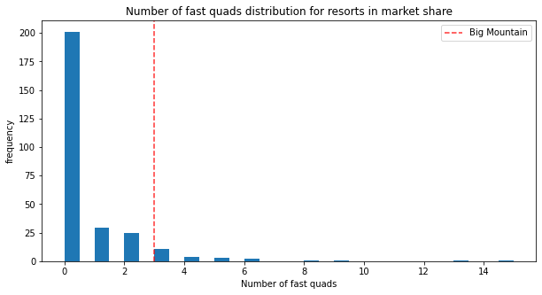
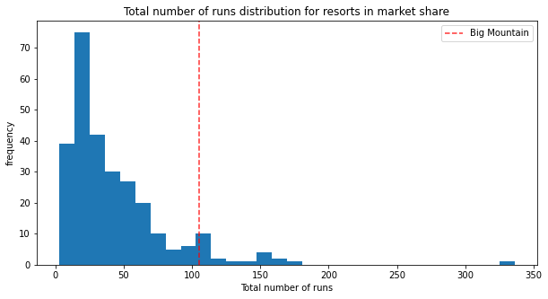
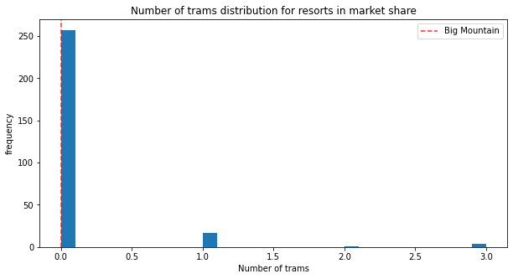
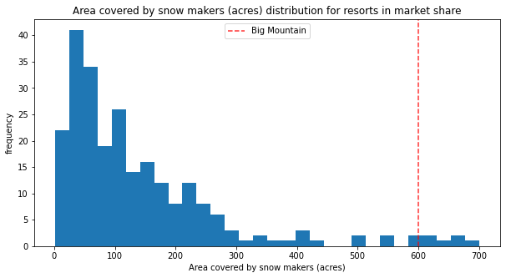
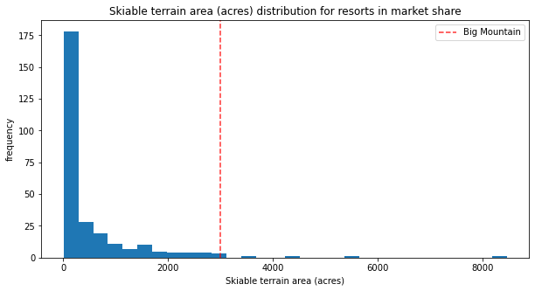
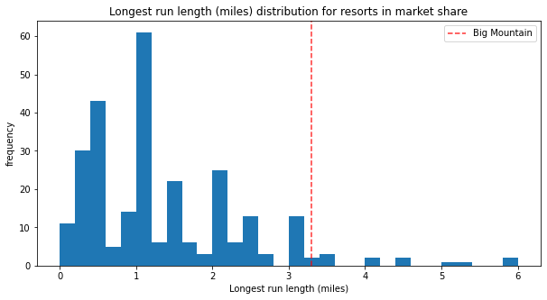
Modeling results and analysis
This analysis provides insights on how Big Mountain compares with other resorts for market share based on a specific feature

Slide 7
Summary and Conclusion
The four potential business scenarios for either cutting costs or increasing revenue (from ticket prices) were evaluated with the model
1. Permanently closing down up to 10 of the least used runs. | Closing one run makes no difference. Closing 2 and 3 reduces support for ticket price and revenue. Closing 4 or 5 runs shows no further loss in ticket price. Increasing the closures down to 6 or more leads to a large drop.
2. Increase the vertical drop by adding a run to a point 150 feet lower down but requiring the installation of an additional chair lift to bring skiers back up | This scenario increases support for ticket price by $16.94 Over the season, this could be expected to amount to $29,652,778
3. Same as number 2, but adding 2 acres of snow making cover | This scenario increases support for ticket price by $19.74 Over the season, this could be expected to amount to $34,546,296
4. Increase the longest run by 0.2 mile to boast 3.5 miles length, requiring an additional snow making coverage of 4 acres | No impact as the model found this was not a feature of importance
The model provides valuable insight for these four scenarios, but can further be utilized to evaluate other potential options.

